Slide 2
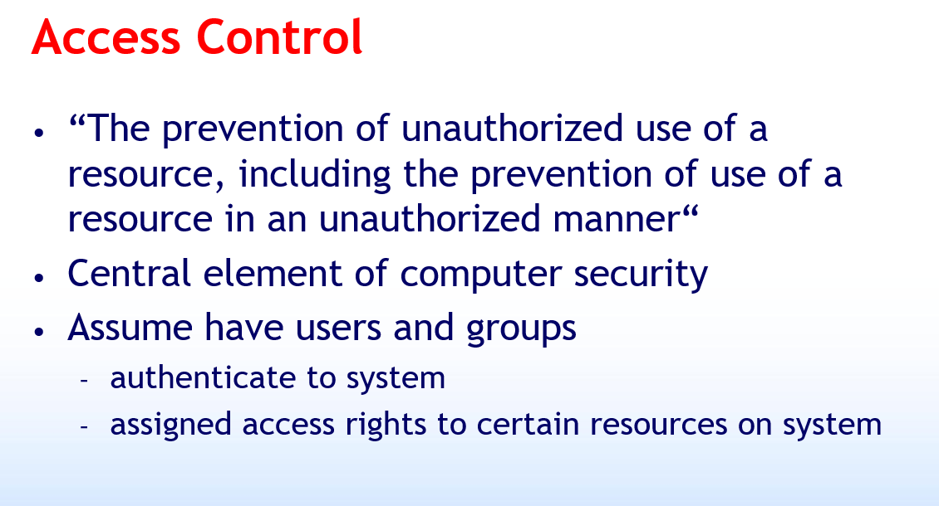

Slide 3
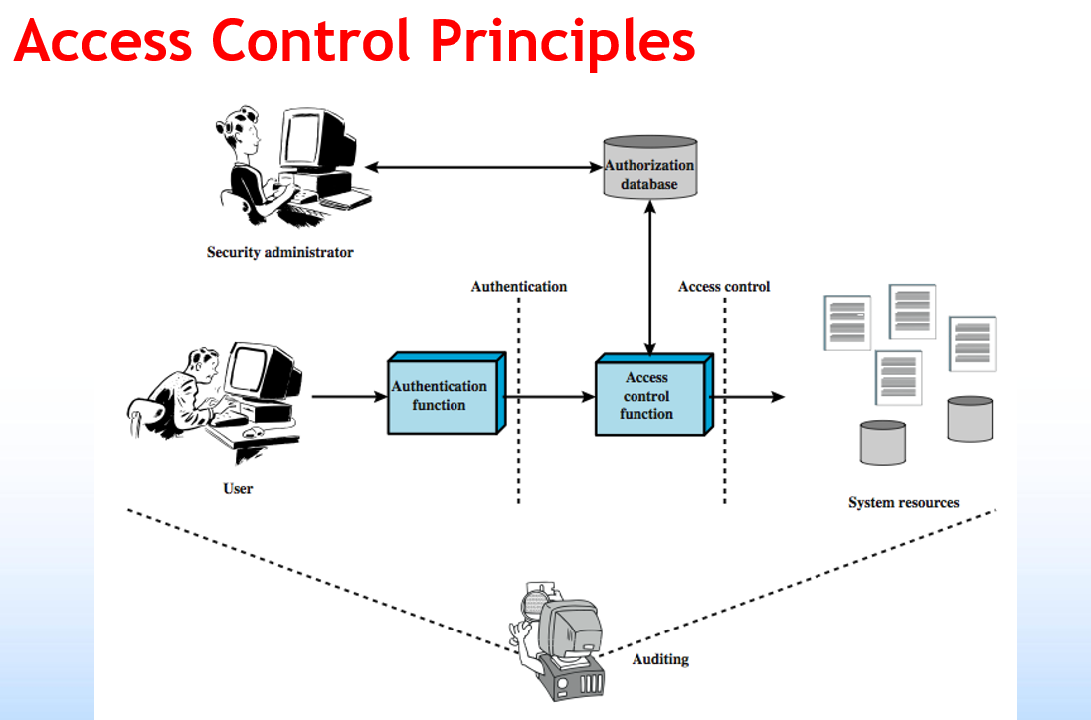

Slide 4
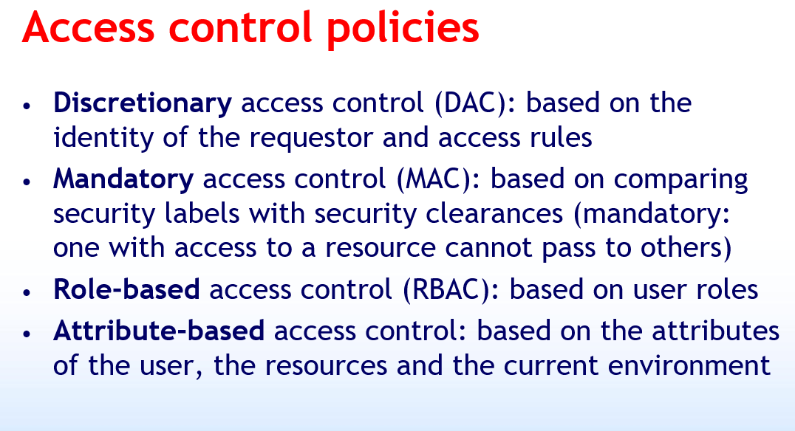

Slide 5
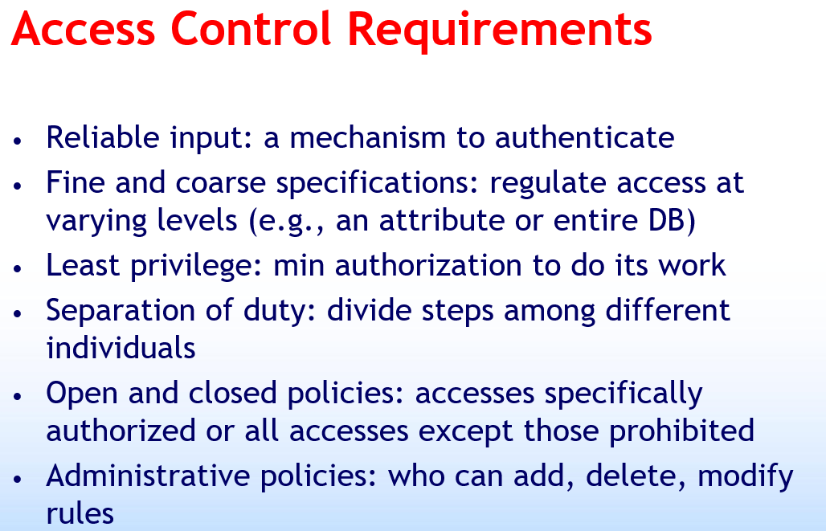

Slide 6
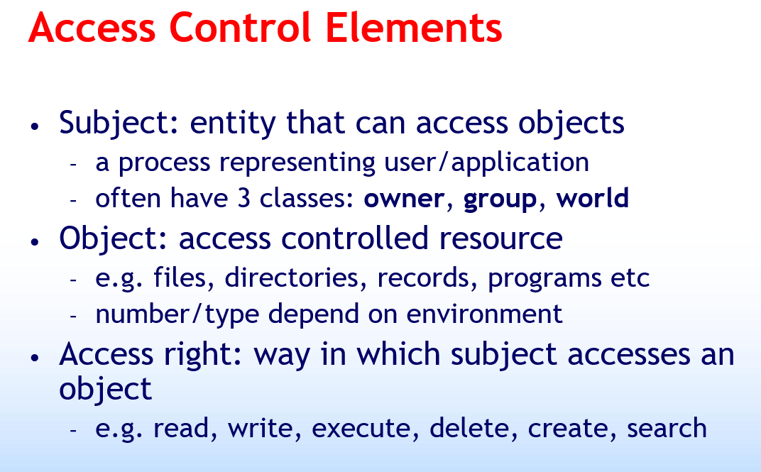

Slide 7
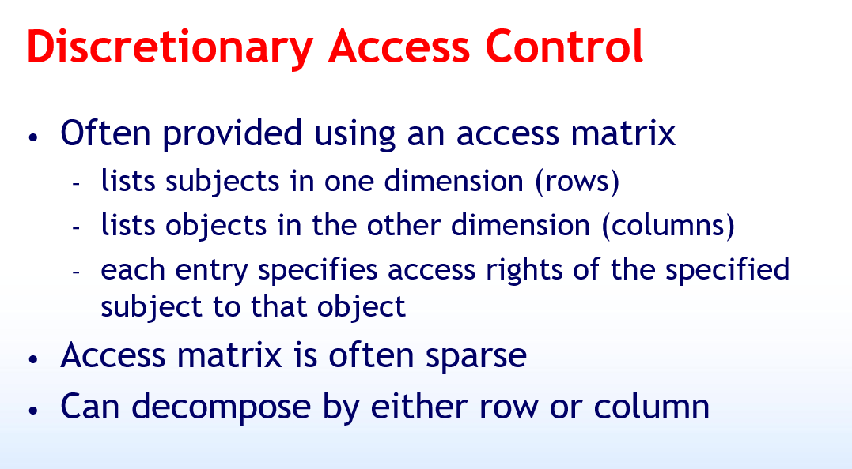

Slide 8
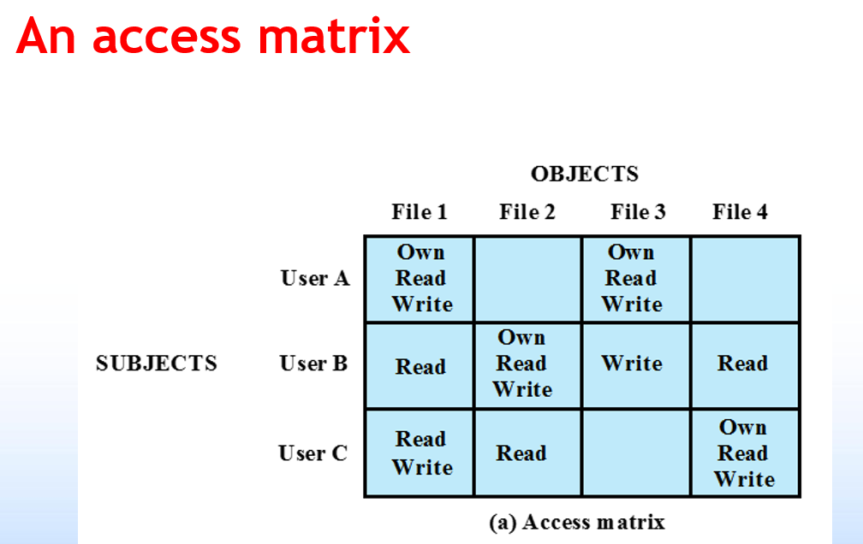

Slide 10
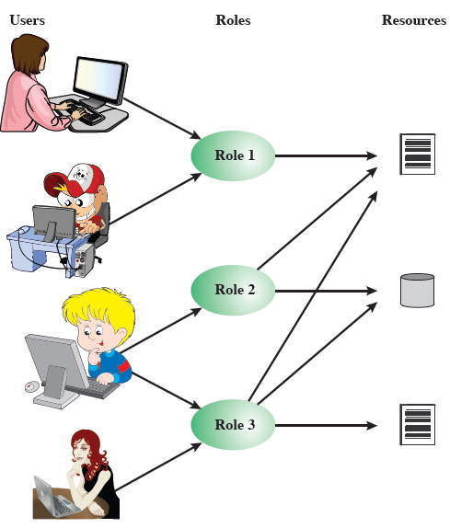
Role-Based Access Control
Access based on
‘role’, not identity
Many-to-many
relationship between
users and roles
Roles often static
Notes:
Traditional DAC systems define the access rights of individual users and groups of users. In contrast, RBAC is based on the roles that users assume in a system rather than the user's identity. Typically, RBAC models define a role as a job function within an organization. RBAC systems assign access rights to roles instead of individual users. In turn, users are assigned to different roles, either statically or dynamically, according to their responsibilities. RBAC now enjoys widespread commercial use and remains an area of active research.
The relationship of users to roles is many to many, as is the relationship of roles to resources, or system objects, as shown here in Figure 4.7 from the text. The set of users changes, in some environments frequently and the assignment of a user to one or more roles may also be dynamic. The set of roles in the system in most environments is likely to be static, with only occasional additions or deletions. Each role will have specific access rights to one or more resources. The set of resources and the specific access rights associated with a particular role are also likely to change only infrequently.

Slide 11
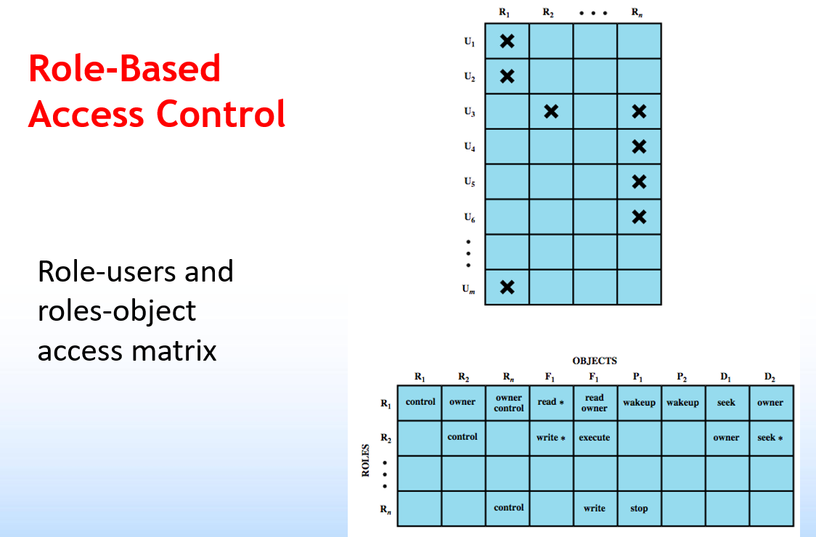

Slide 12
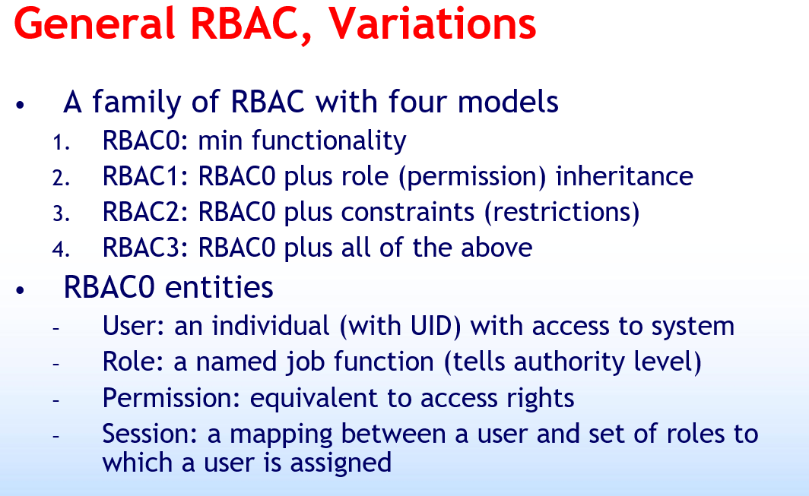

Slide 13
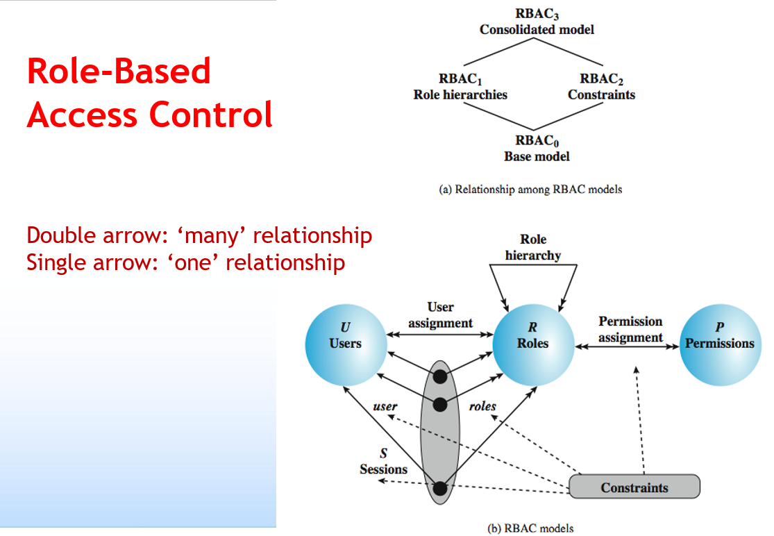

Slide 14
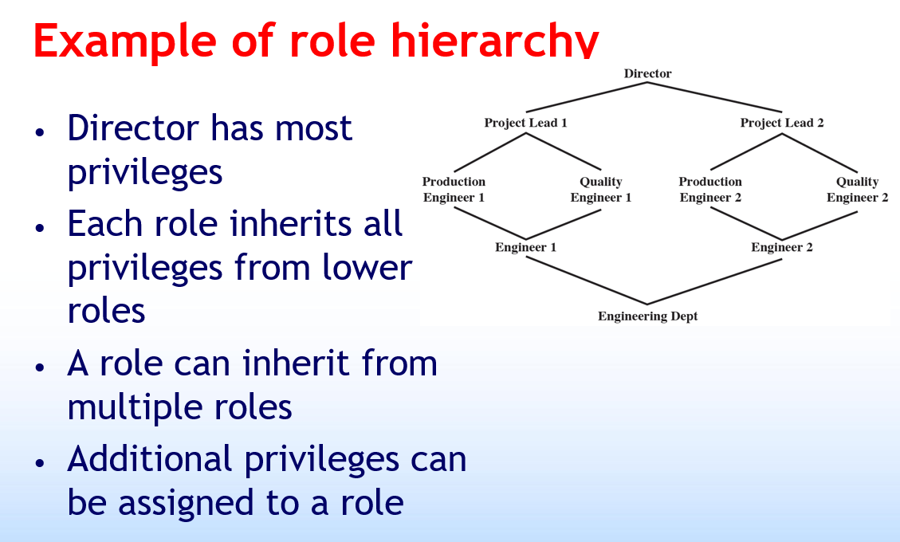

Slide 15
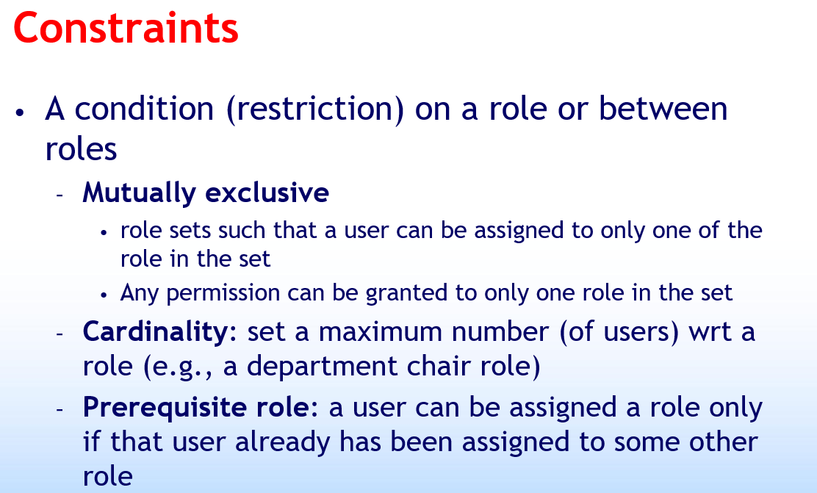

Slide 16
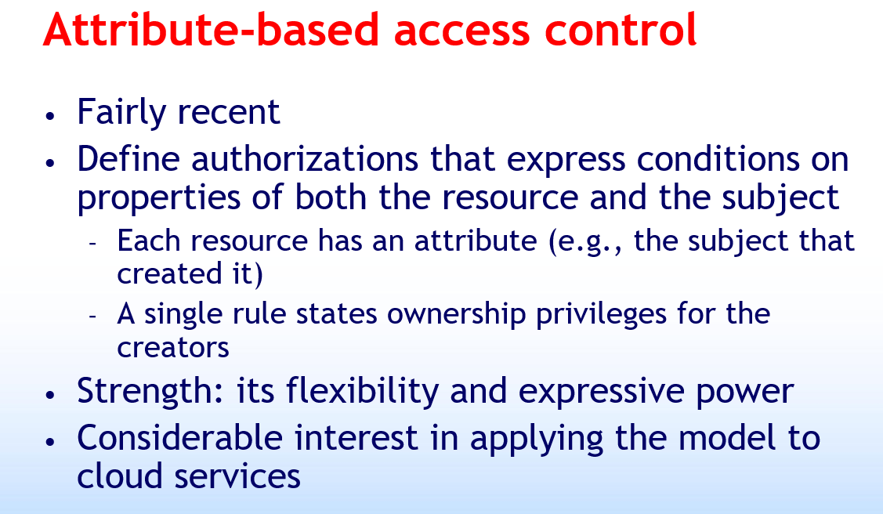

Slide 17


Slide 18
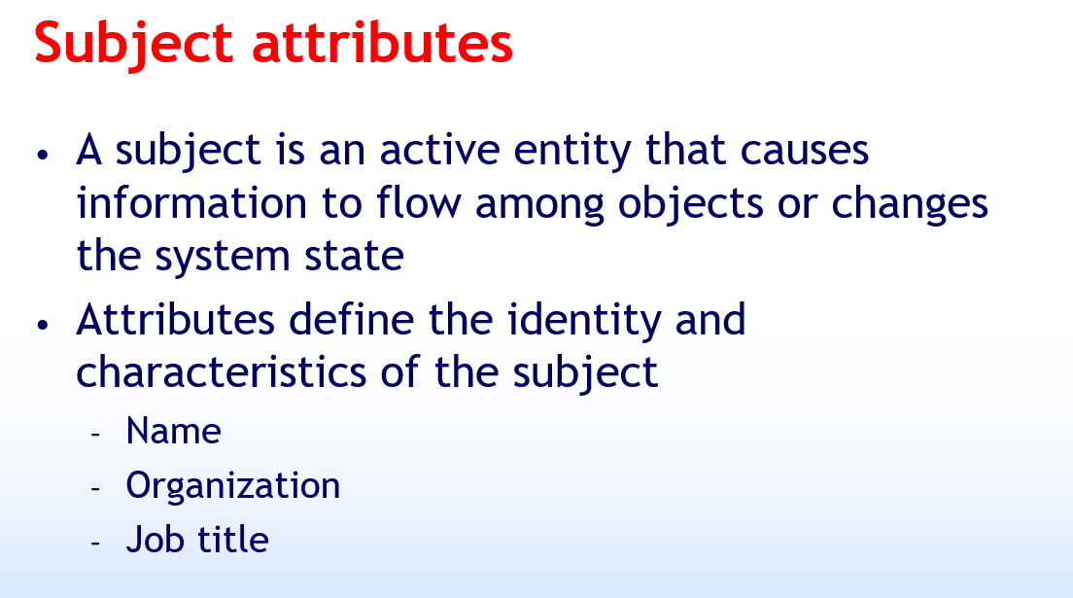

Slide 19
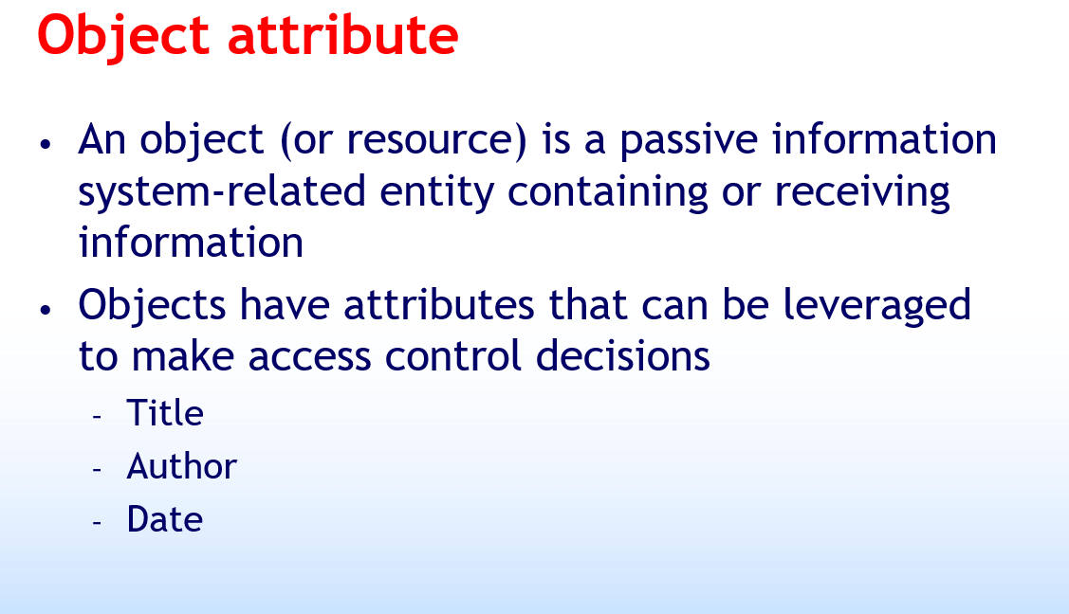

Slide 20
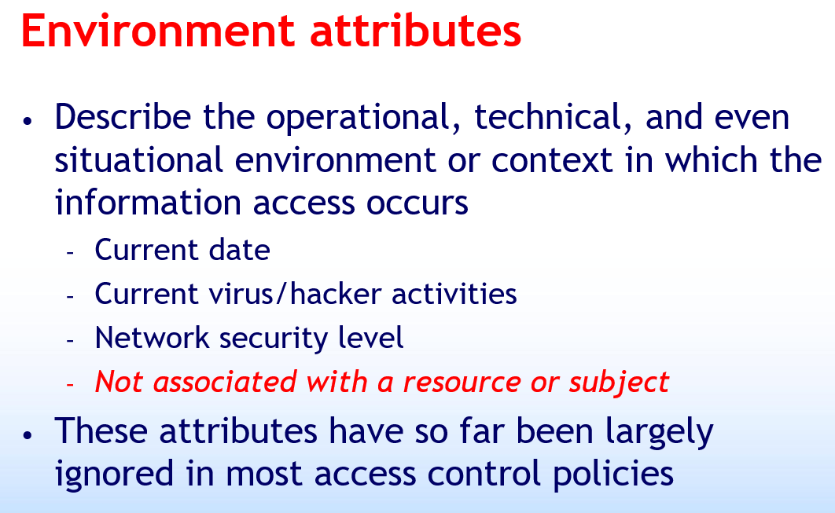

Slide 21
